Slide 1
Interconnection

Slide 2
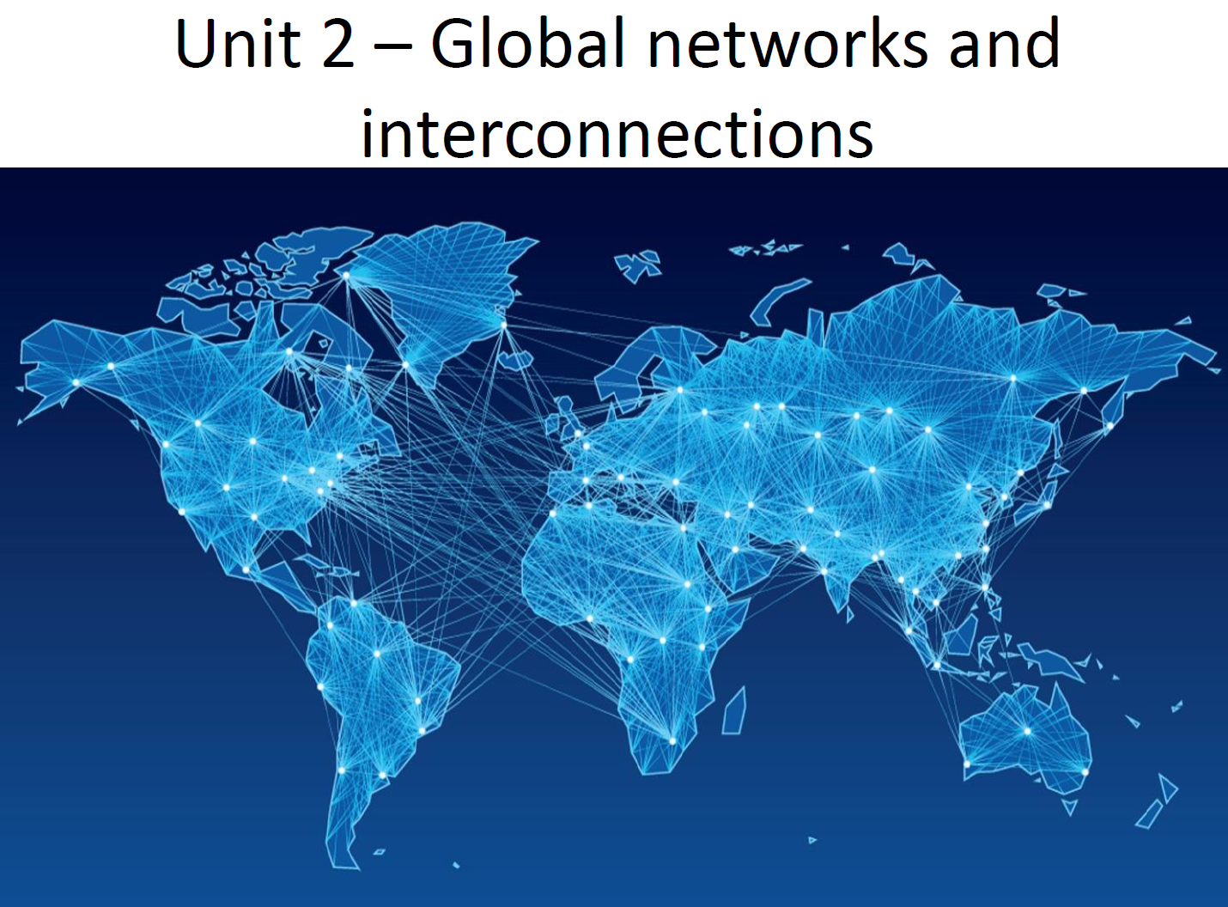

Slide 3
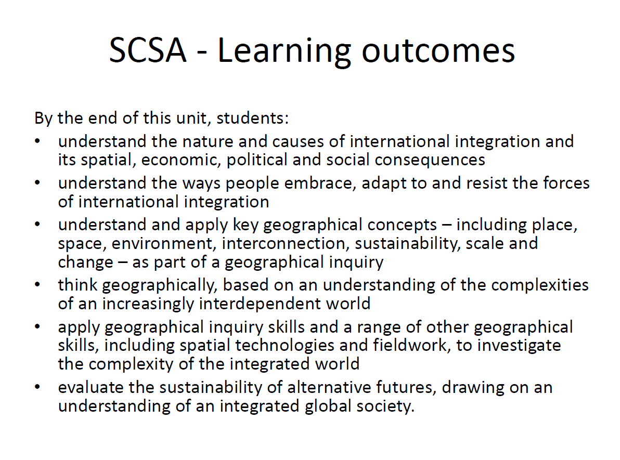

Slide 4
Question!
Think to yourself and write down what ways our world is interconnected and some examples of how we are connected to other places

Slide 5
interconnection
The concept of interconnection emphasises that no object of geographical study can be viewed in isolation. It is about the ways that geographical phenomena are connected to each other through;
environmental processes;
the movement of people;
flows of trade and investment;
the purchase of goods and services;
cultural influences;
the exchange of ideas and information;
political power and international agreements.
language and communication.

Slide 6
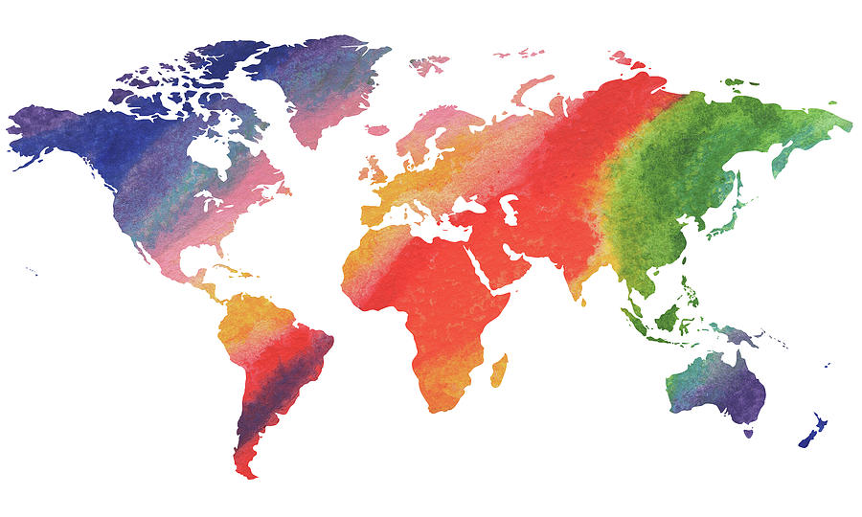
Mapping!
Use two different colours to locate, outline and label the following countries:
Group A: Argentina, Liberia, Namibia, Kenya, South Africa, Mozambique, Oman, Australia, Venezuela.
Group B: Germany, England, Austria, Norway, Croatia, Cyprus, Belarus.
Try to work out the uniting factor that the group countries (A&B) have in common.

Slide 7
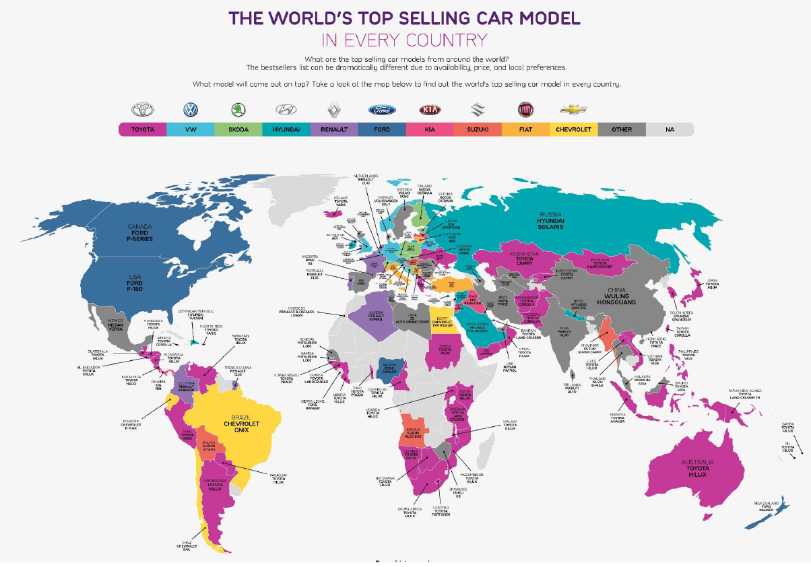

Slide 8
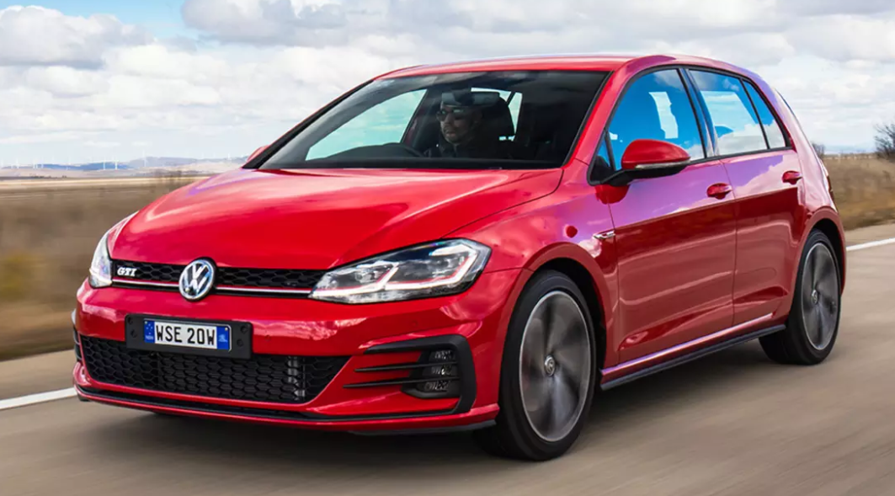


Slide 9
Draw a Venn Diagram comparing the similarities and differences between the two types of vehicles:

Slide 10
Unit 2 – Global networks and interconnections Unit description
This unit focuses on the process of international integration (globalisation) and is based on the reality that we live in an increasingly interconnected world. It provides students with an understanding of the economic and cultural transformations taking place in the world today, the spatial outcomes of these processes, and their political and social consequences. This is a world in which advances in transport and telecommunications technologies have not only transformed global patterns of production and consumption but also facilitated the diffusion of ideas and elements of cultures. The unit explains how these advances in transport and communication technology have lessened the friction of distance and have impacted at a range of local, national and global scales. Cultural groups that may have been isolated in the early twentieth century are now linked across an interconnected world in which there is a ‘shrinking’ of time and space. Of particular interest are the ways in which people adapt and respond to these changes.
Students have the opportunity to explore the ideas developed in the unit through an investigation of the changes taking place in the spatial distribution of the production and consumption of a selected commodity, good or service and the study of an example of cultural diffusion, adoption and adaptation. They also investigate the ways people embrace, adapt to, or resist the forces of international integration.
While the scale of the study in this unit begins with the global, locally based examples can be used to enhance students’ conceptual understanding. The scale of the study for both depth studies, unless specified, can range from local to global, as appropriate.
Students develop an understanding about using and applying geographical inquiry methods, tools (such as spatial technologies), and skills to investigate the transformations taking place throughout the world.

Slide 11
Why is our world “shrinking”?

Slide 12
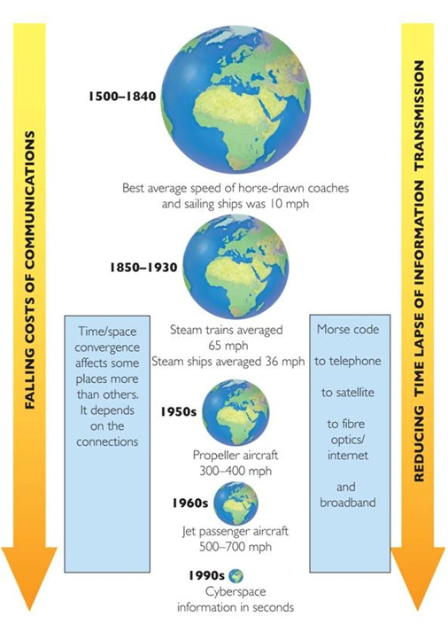

Slide 13
Time-space convergence
This process concerns the changing relationship between time and space, and notably the impacts of transportation improvements on such a relationship. It is closely related to the concept of speed, which indicates how much space can be travelled over a specific amount of time.

Slide 14
Two main factors cause our world to get smaller…
Transportation technology
Communication technology

Slide 15
http://manufacturingmap.nikeinc.com/#

Slide 16
Overview of international integration
the application of the concept of sustainability when considering the outcomes of increased globalisation
the process of international integration, especially as it relates to the transformations taking place in the spatial distribution of the production and consumption of commodities, goods and services, and the diffusion and adaptation of ideas, meanings and values that continuously transform and renew cultures.
advances in transport and telecommunications technologies as a facilitator of international integration, including their role in the expansion of world trade, the emergence of global financial markets, and the dissemination of ideas and elements of culture
the economic and cultural importance of world cities in the integrated global economy and their emergence as centres of cultural innovation, transmission and integration of new ideas about the plurality of life throughout the world
the concept of global shifts with the re-emergence of Asia, particularly China and India, as global economic and cultural powers, and the relative economic decline, but sustained cultural authority, of the United States of America and Europe

Slide 17
the application of the concept of sustainability when considering the outcomes of increased globalisation

Slide 18

Name this sound…

Slide 19
advances in transport and telecommunications technologies as a facilitator of international integration, including their role in the expansion of world trade, the emergence of global financial markets, and the dissemination of ideas and elements of culture

Slide 20
Communication the internet

Slide 21
Question: What is the internet and why has it grown?

Slide 22

History of the internet

Slide 23
Question: how do we get the internet?

Slide 24


Slide 25

Network of undersea cable

Slide 26
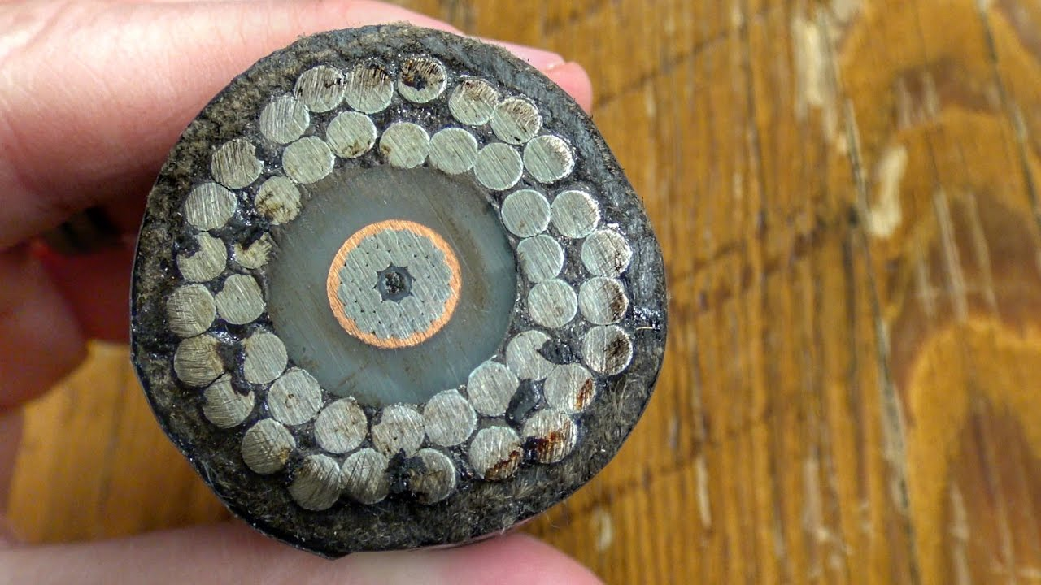

Slide 27
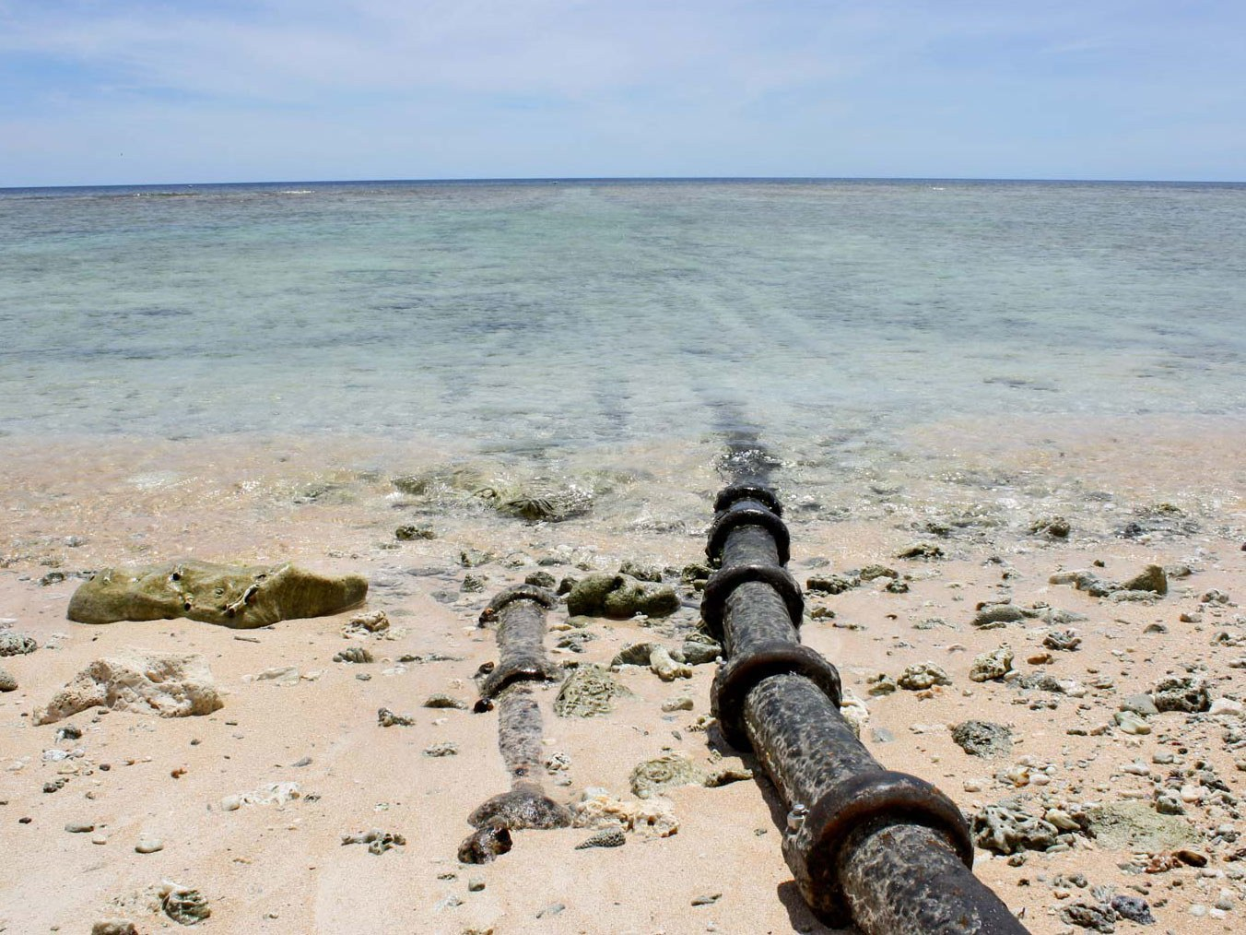

Slide 28
Important!
The internet does not just exist as a 'cloud' concept it is based in physical technology and networks.

Slide 29
Dangers to undersea internet cables

Slide 30
Andrew blum: What is the internet really? Ted talk

Slide 31
What is sea-me-we-3?

Slide 32
The internet is…
An electronic communications network that connects computer networks and organisational computer facilities around the world.
The Internet is a collection of standalone computers all loosely linked together, mostly using the telephone network. The connections between the computers are a mixture of old-fashioned copper cables, fibre-optic cables, wireless radio connections, and satellite links.
It began as a project by the US military in 1983.

Slide 33
Name the 2 factors that are making our world “Shrink”

Slide 34
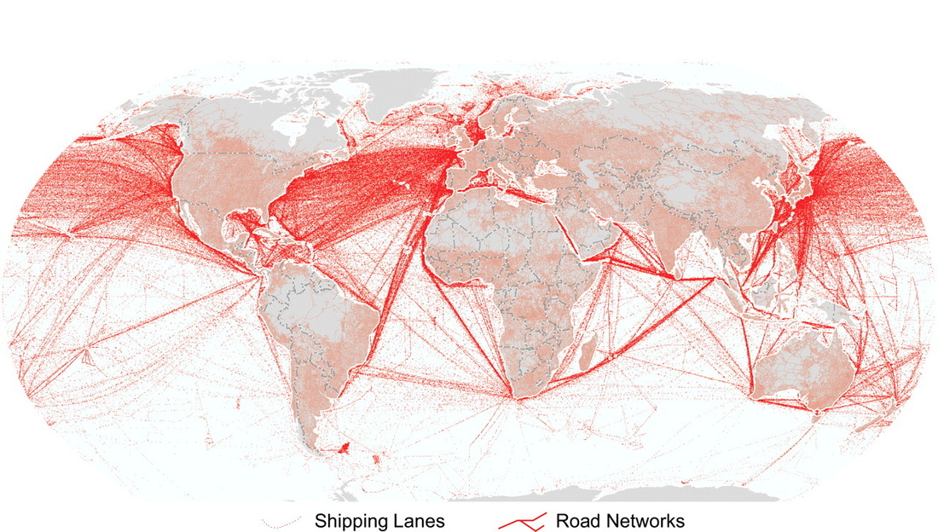

Slide 35
transportation making our world shrink

Slide 36
shipping

Slide 37
https://ourworldindata.org/trade-and-globalization
http://www.tradeready.ca/2015/trade-takeaways/four-ways-international-trade-changed-one-hundred-years/
https://www.youtube.com/watch?v=LKon0l5hq7s 6 mins tour of a container ship
https://www.youtube.com/watch?v=DY9VE3i-KcM
https://www.youtube.com/watch?v=0MUkgDIQdcM 4 mins brief history of shipping
https://www.youtube.com/watch?v=-jl5y-1ewW8 suez canal
https://www.youtube.com/watch?v=WR_hCMR2Xvc 9 mins panama canal

Slide 38
What invention beginning with ‘c’, revolutionised world trade?

Slide 39
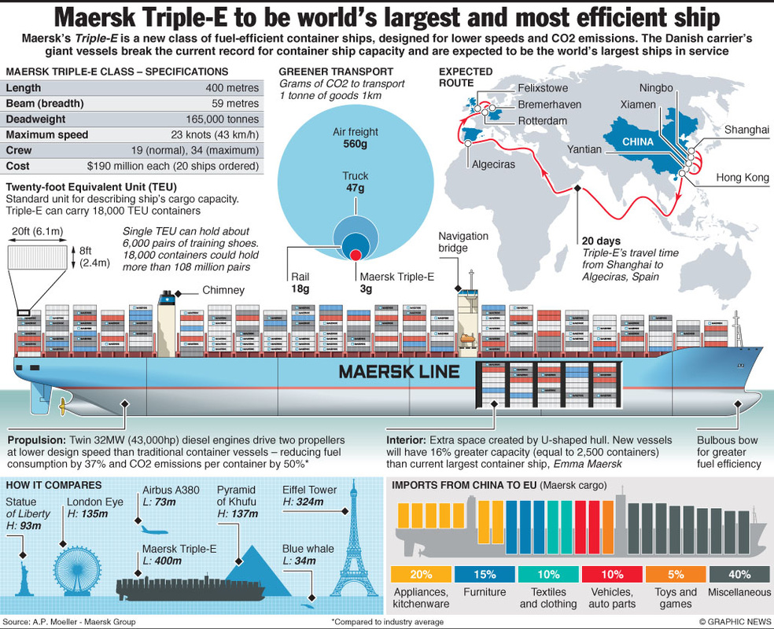

Slide 40
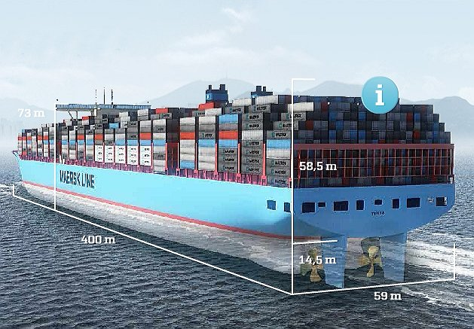

Slide 41
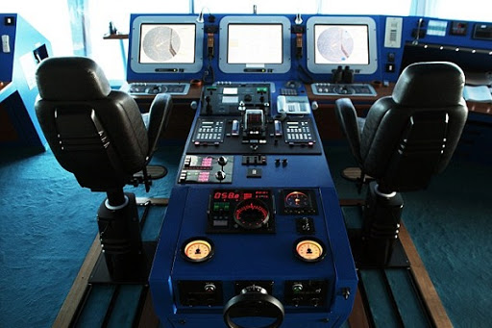

Slide 42
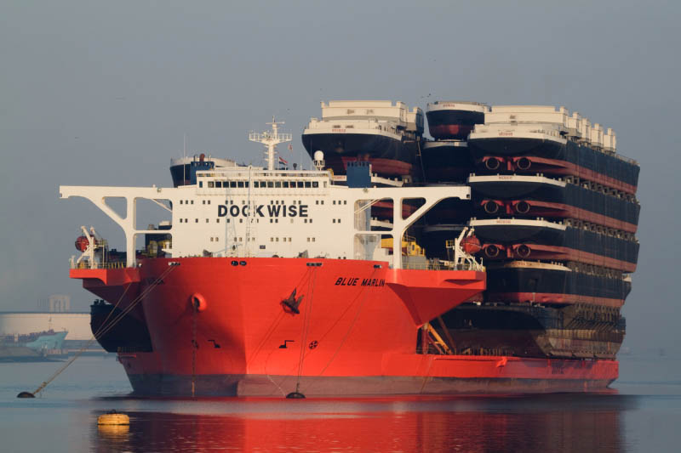

Slide 43
Write down and answer
Containerisation: a shipping method in which a large amount of material (such as merchandise) is packaged into large standardized containers
Questions
List three benefits this innovation has had
How has it contributed to our world shrinking?

Slide 45
textbook
Pages157- 160 WA ATAR Geography Units 1 & 2
Read the chapter

Slide 46
Communication mobile phones

Slide 47

ON April 3, 1973 Martin Cooper made a call on this hefty, hand–held device and made history.

Slide 48
Things have certainly changed a bit since then...

Slide 49
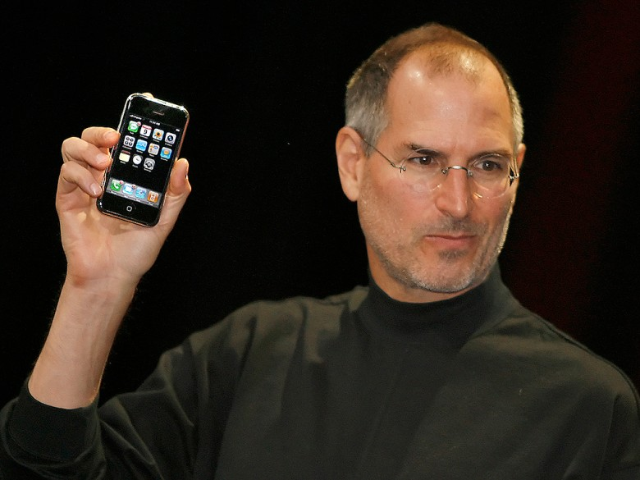

Slide 50
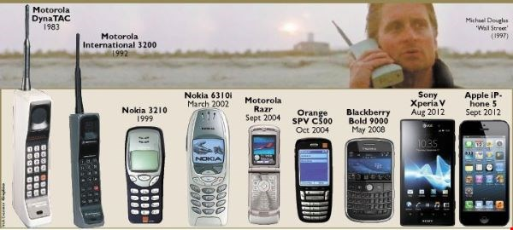

Slide 51
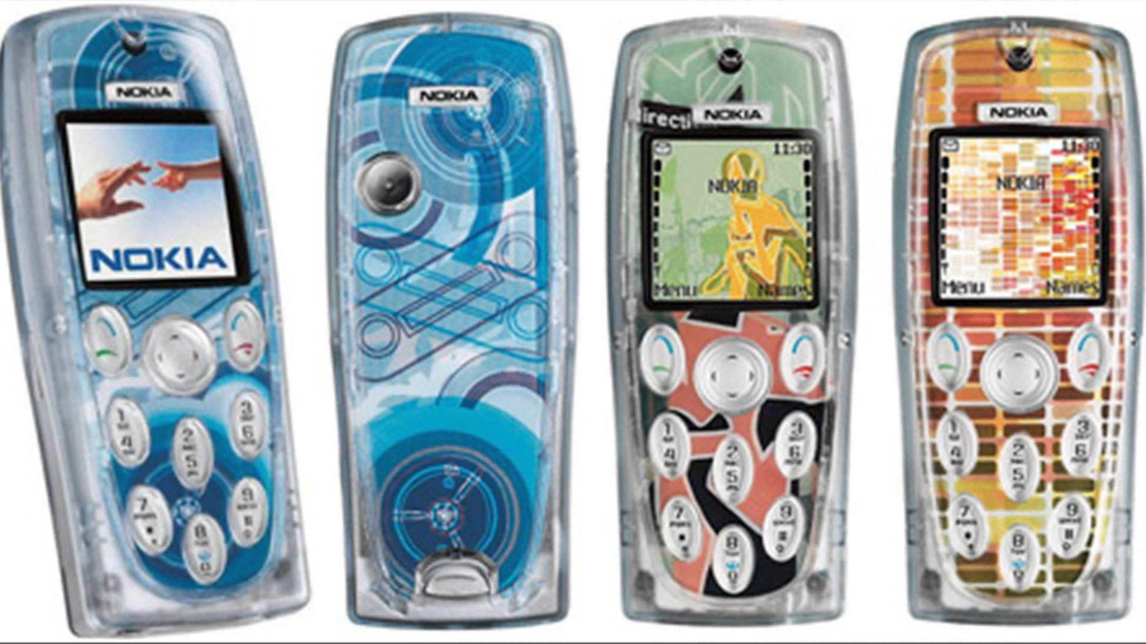

Slide 52

Compare the top mobile phone using countries in the world.
Pay special attention to number of phones per 100 people.

Slide 53
Activity
Watch the following clip and make notes on how mobile phones have changed over the last few years in the form of an RIQ 321
3 x Remember/Recall
2 x Interesting
1 x Question

Slide 55
Activity
Watch the following clip and in your notes list 9 uses of mobile phones.

Slide 57
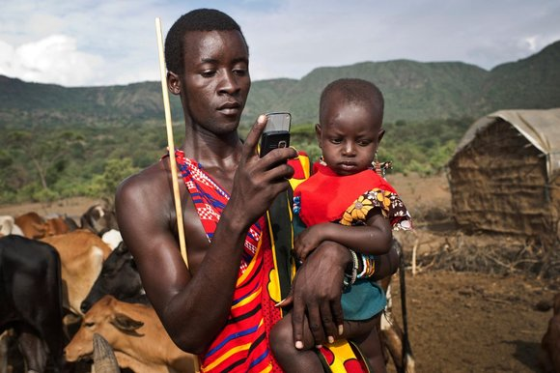
Explain with examples why Mobile Phones are now being referred to as Mobile Devices.
Hint: what capabilities do they now have?
Use full sentences and supporting evidence in your response.
When you have finished answering this question, please bring you response to me to read. Collect a copy of Pearson 9 and read pages 140 – 141.
Complete activities 1 – 7 in your HASS notes.
Read pages 138 -139.

Slide 58
Page 132 Read & complete activities 1-5
Computer parts mapping activity
You will need: an atlas, ruler, blank world map and the information sheet
Instructions: read the information sheet and then complete the following.
On the map draw a line from each of the countries where parts were manufactured to the country where they were assembled (USA). (Draw one line per country)
How many countries were involved in the manufacturing of the computer? (label these countries on your map)
Thomas Friedman said that the LCD display might have been made in a factory in one of three different countries. List those three countries. (colour them in red)
A factory can be owned by a company in a different country to the one it is situated in. Write down the countries which have Korean owned factories. (colour them in green)
Name/label three countries that have Samsung factories. – label them as “Samsung Factories”
Label the continents and oceans.
Answers these questions in your HASS books
6. How would you describe the nationality of your computer?
7. What does this tell us about the relationships between these countries?
8. Write down four other pieces of electrical equipment which may have parts created in other countries.

Slide 59
http://www.abc.net.au/news/2017-09-07/delta-flight-races-hurricane-irma-into-and-out-of-puerto-rico/8881434

